Slide 1

Analysis of Order Data from Brazil's Largest E-Commerce Company
Vlad Lee

Slide 2
Background
Brazil's e-commerce revenues more than doubled since 2019 to over $30 billion
In comparison, U.S. e-commerce market generated over $1.2 trillion in revenues in 2024
Olist founded in 2015
Connects customers with small and medium-sized businesses
Provides logistics, analytics, and customer support
Unicorn start-up and one of fastest growing companies in 2021

Slide 3
Dataset
Obtained from Kaggle

Slide 4

Dataset
Obtained from Kaggle
100k orders from 2016 to 2018
Notable Fields: order status, price, payment type, review_score

Slide 5
Data Cleaning and Preparation
Order may contain multiple items
Each item may be fulfilled by different seller
Aggregated price of each item in order
Calculated Average rating for each order
Order reviews dataset does not contain product level detail
Merging payment, customer, and review details with orders
Created dataset of Brazil state names and abbreviations
Cleaned column name, product names strings (i.e. removing special characters)

Slide 6




Objectives and Research Questions
1
How are customers and sellers distributed geographically?
2
What are the most/least popular product categories?
3
How do certain factors affect review scores?

Slide 7
Analysis and Visualization

Slide 8
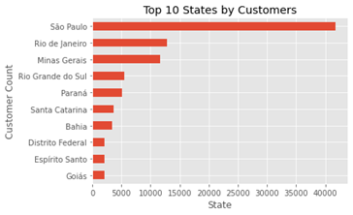
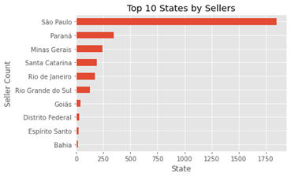
Geographic Distribution of Customers and Sellers

Slide 9
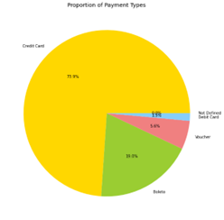
Payment Types
70%+ orders were paid by credit card
Boleto (Bank Ticker or Bank Slip): 20%

Slide 10
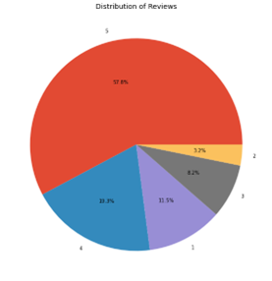
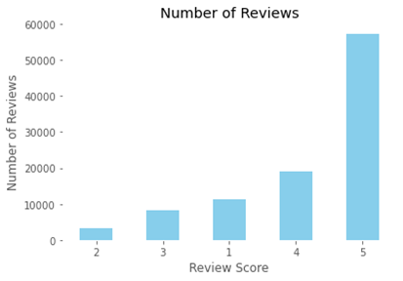
Reviews
Review scores range from 0 to 5 (in 0.5 increments)
Over 99% of orders are reviewed
4 or 5 star reviews account for 80% of all reviews

Slide 11
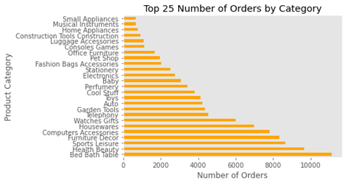
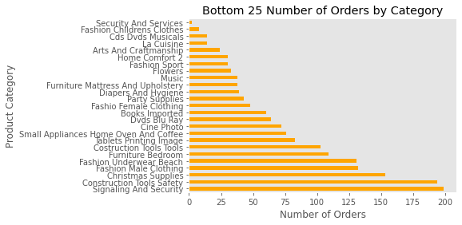
Popular Products
Bed Bath Table, Healthy Beauty, and Sports Leisure are the 3 most popular categories
Security and Services, Fashion Childrens Clothes, and Cds/DVDs/Musicals are the 3 least popular categories

Slide 12
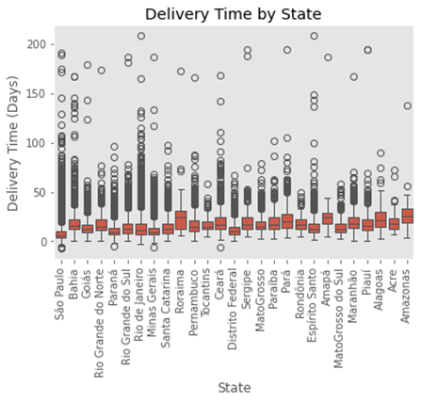
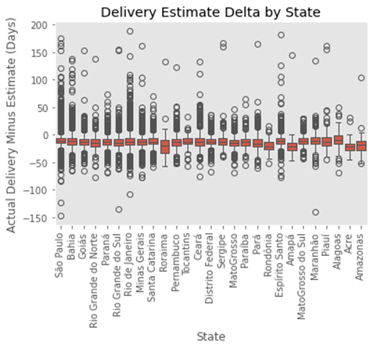
Delivery Time
Roraima, Para, and Amazonas have the widest range of delivery time
Roraima and Amazonas are the least accurate in delivery estimates

Slide 13
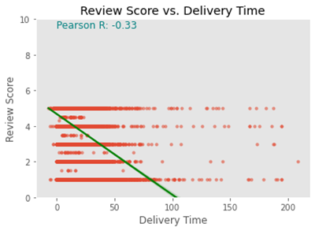
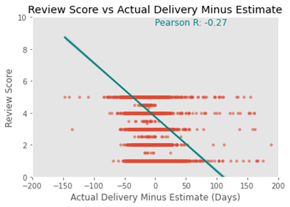
Review Score vs. Delivery Time
Delivery time and the difference between actual delivery minus estimated delivery are inversely related to review score
Pearson R coefficients are on the low end

Slide 14
Conclusion
Most customers and sellers are concentrated in Brazil's most populous states
Credit cards and bank notes dominate the payment types
Reviews tend to be favorable, indicating high customer satisfaction
Delivery times can vary significantly based on geolocation, potential to enhance operational efficiencies
Delivery time does not have a major impact on customer satisfcation

Slide 15
Future Work and Considerations
NLP/sentiment analysis of reviews
Expand data set to include COVID years
Seasonality analysis of revenues and delivery time
How have revenues average ratings changed over time for each product category?
Examine the relationship between number of photos and review score

Slide 16
Links
Github Repo
Linkedin

